Slide 1


Straw hats – Team 454
Final Project
A Machine learning based project to detect depression

Slide 2
Machine learning based depression detection web app

Slide 3

AGENDA
You may be going through a depression and may not know about it .
For solving this problem we have developed a web app to check whether you may be going through depression or not .

Slide 4

PROBLEM STATEMENT
A web app to detect whether a person is going through depression by evaluating him/her through a set of questions which would hardly take 3 minutes to solve .

Slide 5

PROJECT OVERVIEW
We have used a dataset from Kaggle which have records of different people who are suffering from depression and feelings that they are going through .
Our ML model is trained on SVN Classifier which is giving us an accuracy of 99.7 %
Some of the features of our dataset are :
Pleasure in doing things
Feeling depressed or hopeless
Trouble in sleeping or sleeping too much
Poor appetite or over eating
Based of 10 feelings of the user we collect data and then we feed it to the trained ML model.

Slide 6

WHO ARE THE END USERS?
Students
Middle or old age people
Any person having a hard time

Slide 7

OUR SOLUTION AND ITS VALUE PROPOSITION
A web app to detect whether a person is going through depression by evaluating him/her through a set of questions which would hardly take 3 minutes to solve .
Based on how user if feeling, he will select appropriate answers to our questions . The answers given by the user will be feed to the trained ML model.
The model assesses the answers to the questions with actual answers and gives a conclusion whether the user is in depression or not.

Slide 8
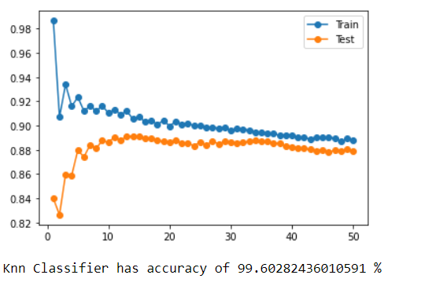
THE WOW IN OUR SOLUTION
It takes less than 3 minutes to complete the test and get score .
Our trained model is giving a Accuracy of 99.7 % which is near to 100%

Slide 9
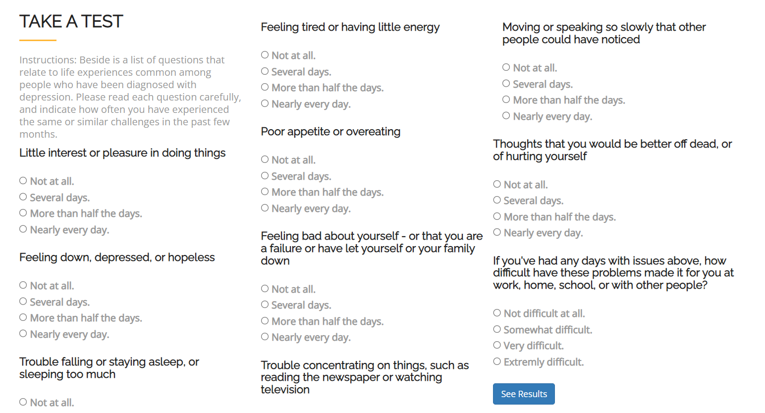
MODELLING
Our Index/Test Page

Slide 10

Result Page
After evaluation of scores you will get the result .
We have following fields :
No Depression
Mild Depression
Moderate Depression
Moderately severe Depression
Severe Depression
Github Link(Click Link)

Slide 11


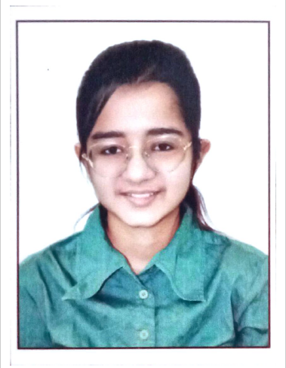
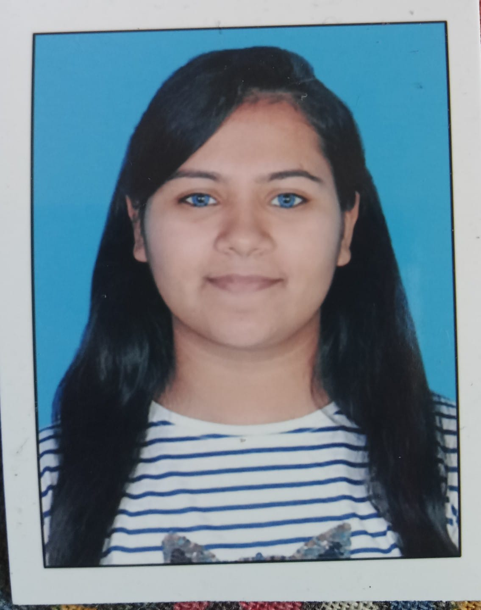
MEET OUR TEAM
Team Leader : Shubham Patel
Devanshi Patel
Hirva Rao
Parita Thakkar
.
.

Slide 12

CREDITS
Stakeholders | Subject Matter Experts(SMEs) | Coaches

